Slide 1
Demo : Zero-Reference
Deep Curve Estimation for Low-Light Image Enhancement
CVPR 2020 - Chunle Guo, Chongyi Li, Jichang Guo, Chen Change Loy, Junhui Hou, Sam Kwong, Runmin Chong
BIIT Lab, Tianjin University, City University of Hong Kong, Nanyang Technological University, Beijing Jiaotong University
Ivan Surya H - 0860812
M. Farhan Tandia - 0860814
Martin Dominikus - 0856643

Slide 2
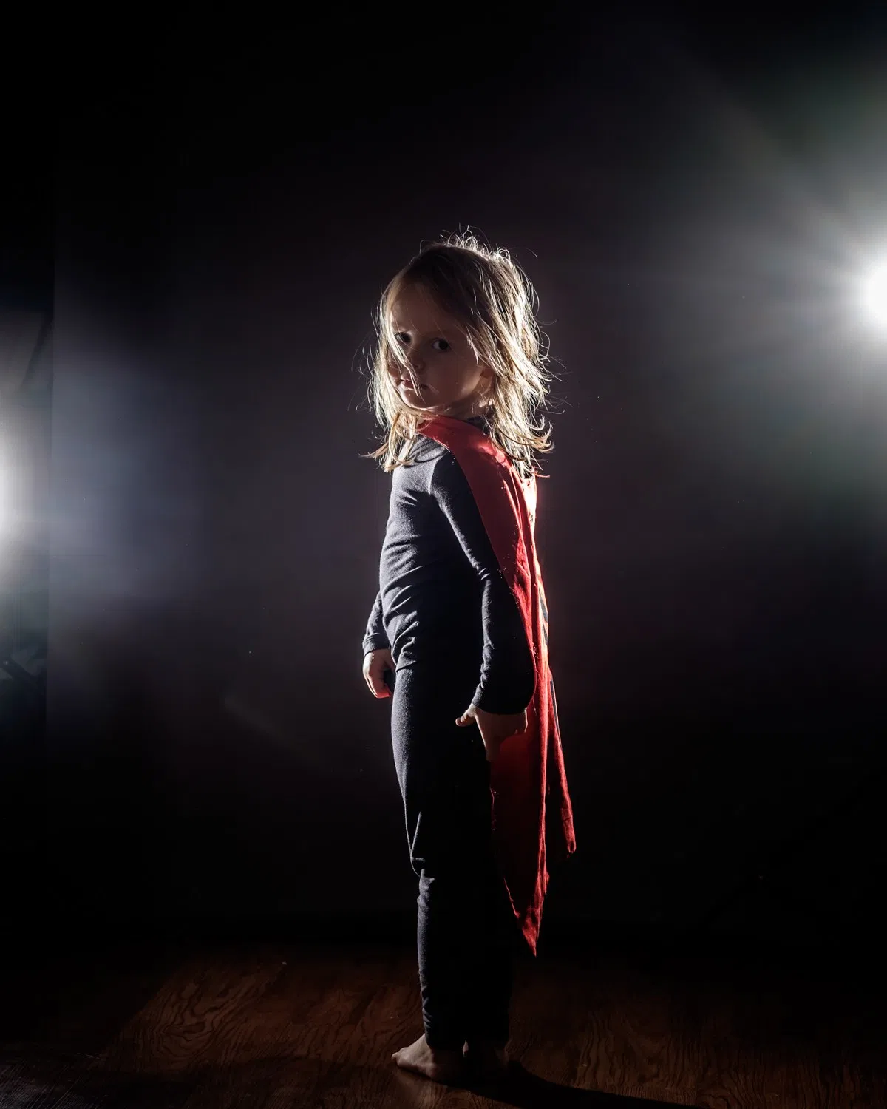
What is Zero-DCE?
Zero-DCE is a novel method to do light enhancement in an image. We could obtain do light enhancement in image while keep maintain the detail and preserves quality of the image
Using common image format (.jpeg,.png,.bmp, etc.)
No label needed (Zero Reference)
SOTA on low-light image enhancement

Slide 3

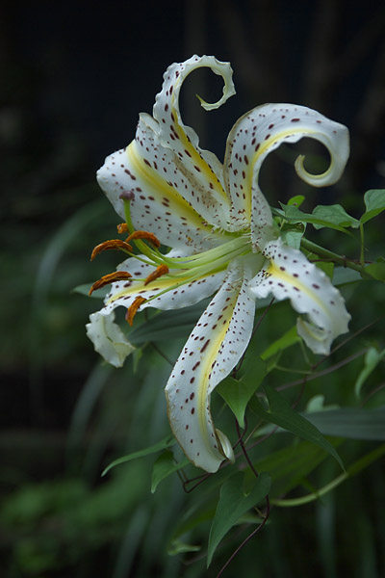
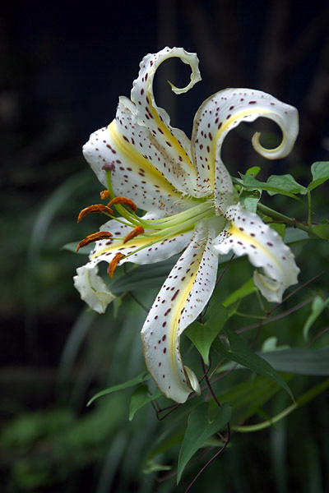
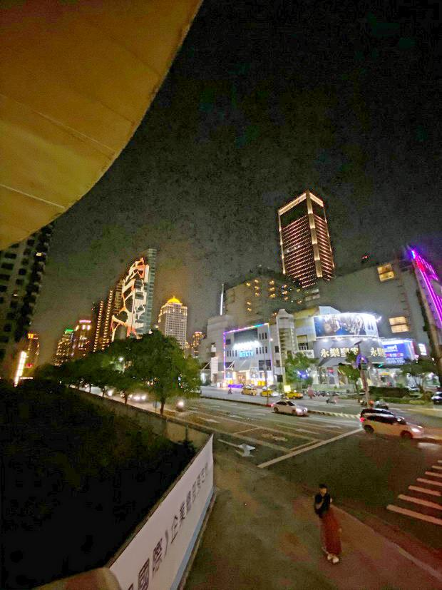
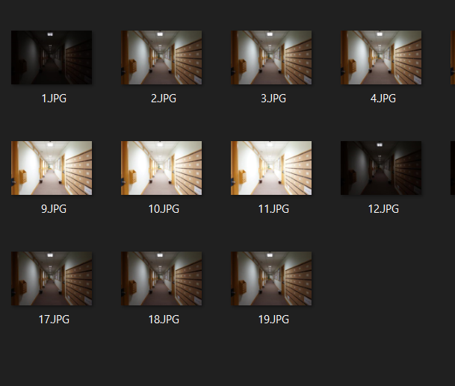
Improvement
Color Correction
Image Denoising
Training Data
Fix the color issues and make footage appear as naturalistic as possible
Removing noise
Use a larger amount of training data
“Ready for Production”

Slide 4
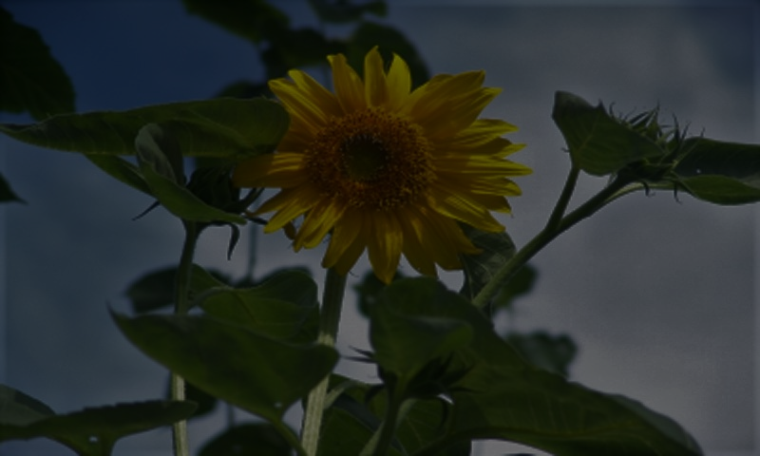
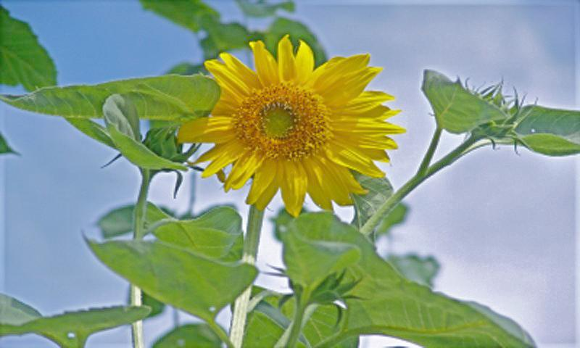
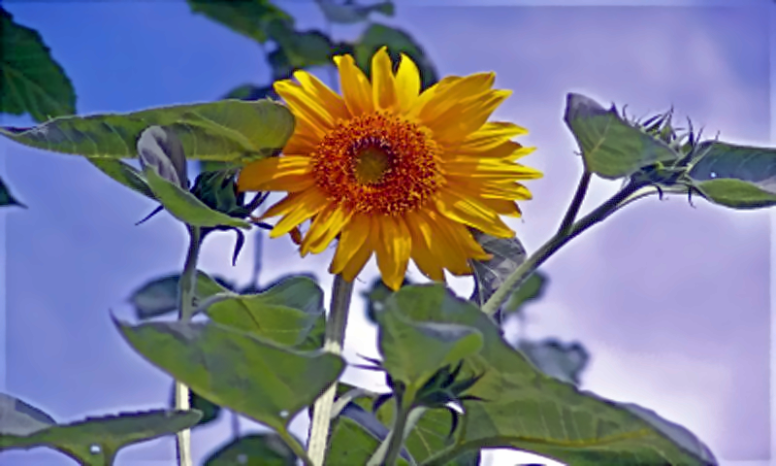
Color Correction
Illuminant Estimation
Performs color balancing via histogram normalization.
Determine the histogram for each RGB channel and find the quantiles that correspond to our desired saturation level.
Cut off the outlying values by saturating a certain percentage of the pixels to black and white.
Scale the saturated histogram to span the full 0-255 range.
Input
Zero-DCE
Zero-DCE + Color Correction
Low Light
Too Vibrance Color Balancing
Limare, Nicolas & Lisani, Jose-Luis & Morel, Jean-Michel & Petro, Ana-Belen & Sbert, Catalina. (2011). Simplest Color Balance. Image Processing On Line. 1. 10.5201/ipol.2011.llmps-scb.

Slide 5
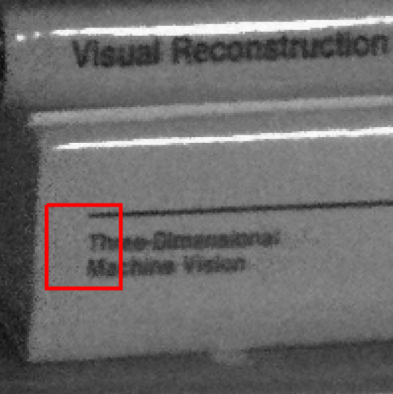
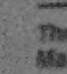
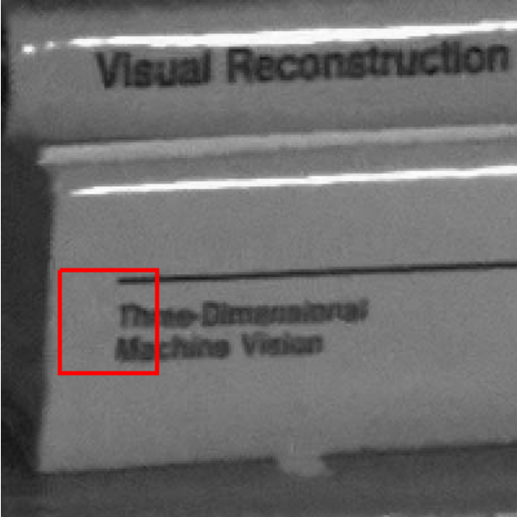
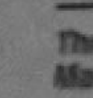
Image Denoising
Algorithm: Non-local Means Denoising
OpenCV implementation based on Buades, Coll, Morel (2005)
The ideas
Assume that the noise is a random variable with zero mean
One can get the noise by averaging the differences between many similar image sequences
In the case of single image, calculate the mean of all image patches which are similar and redundant
Source:
Buades, Coll, Morel (2005)
Noisy
Restored

Slide 6
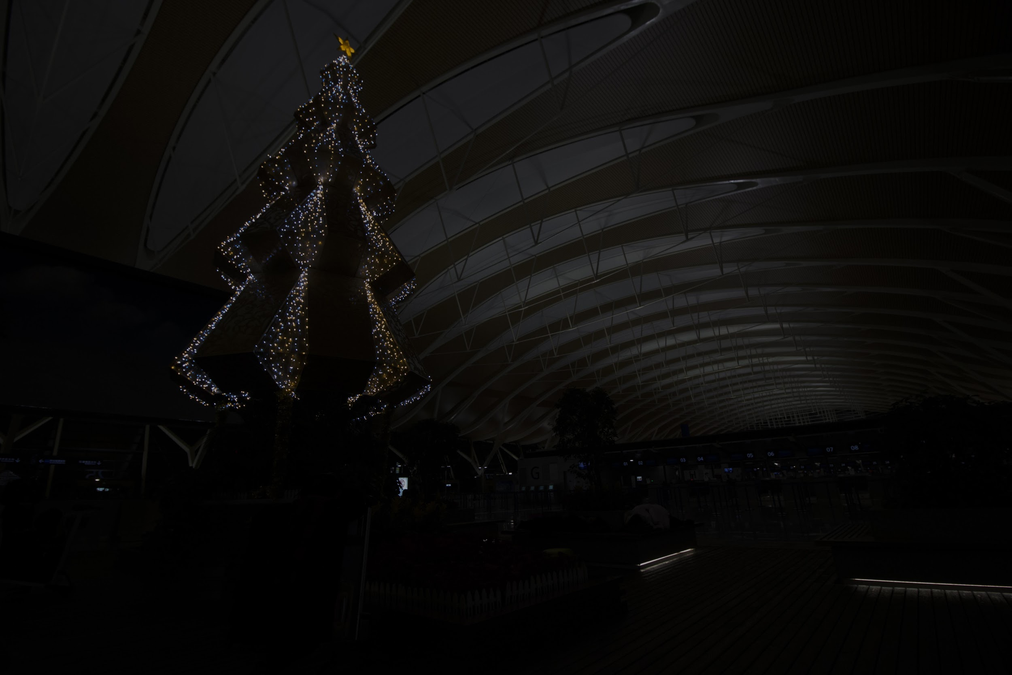
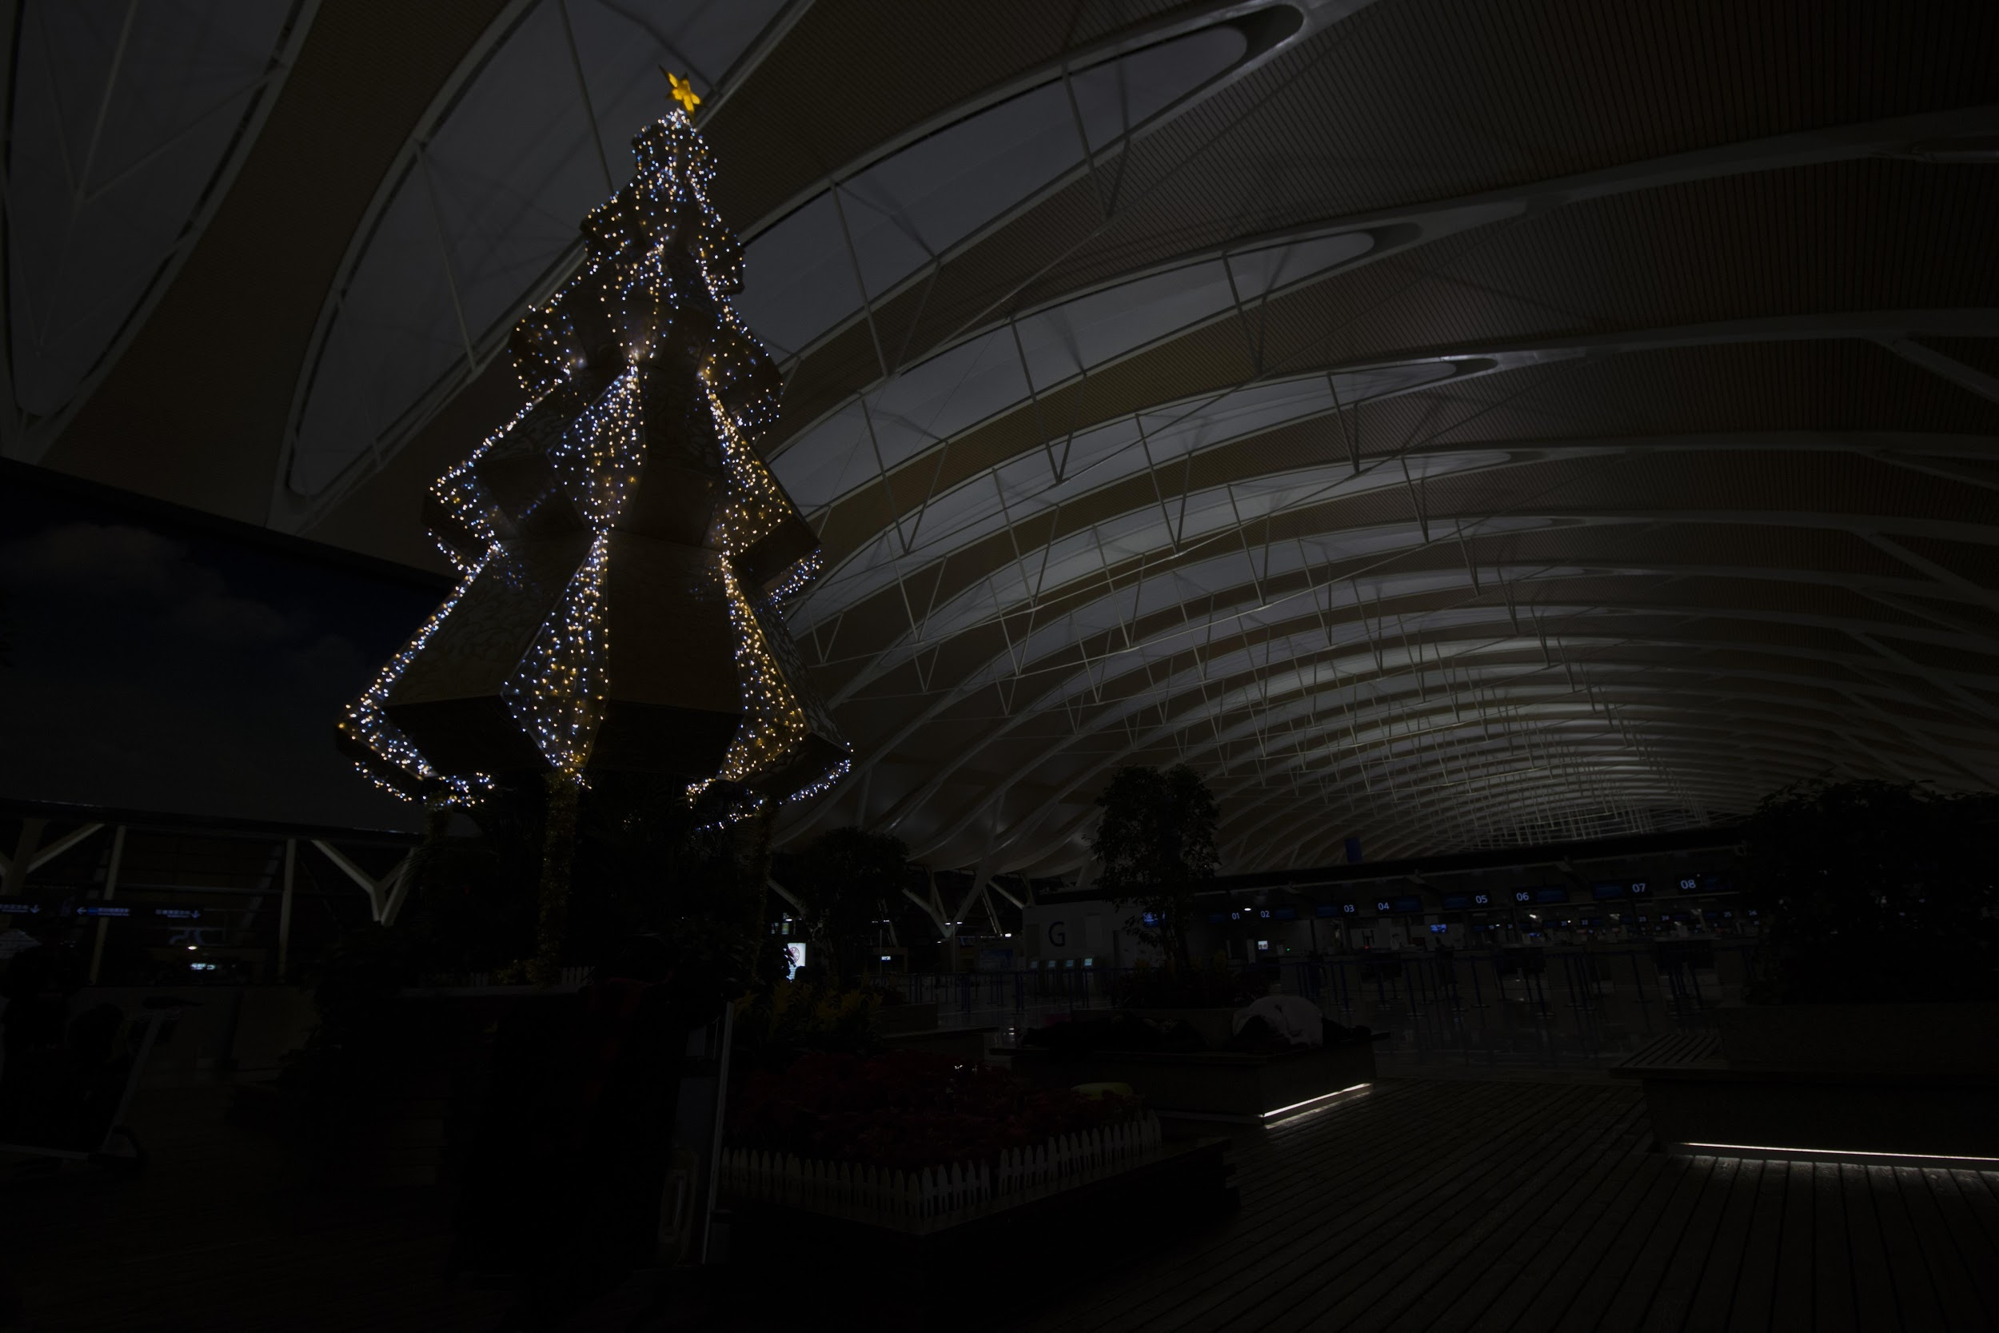
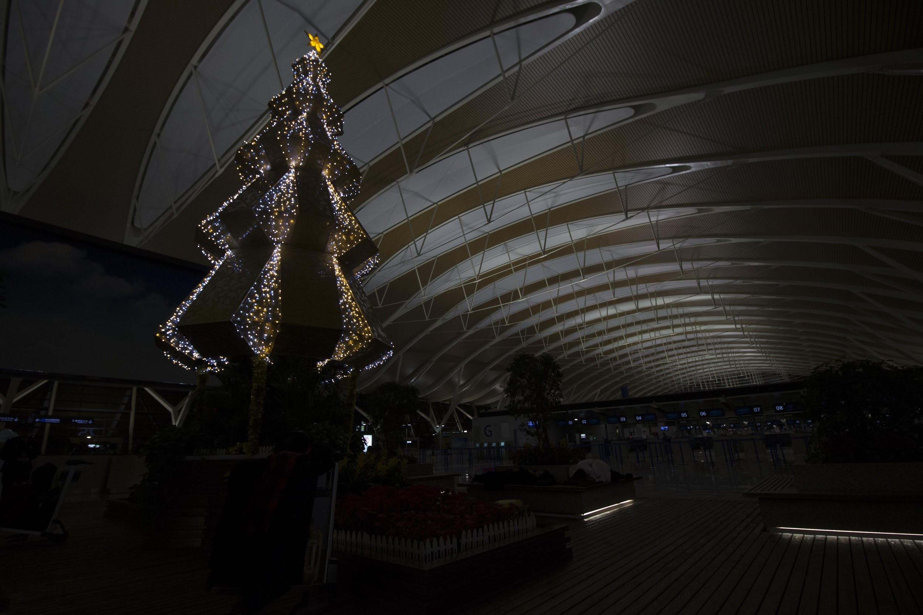
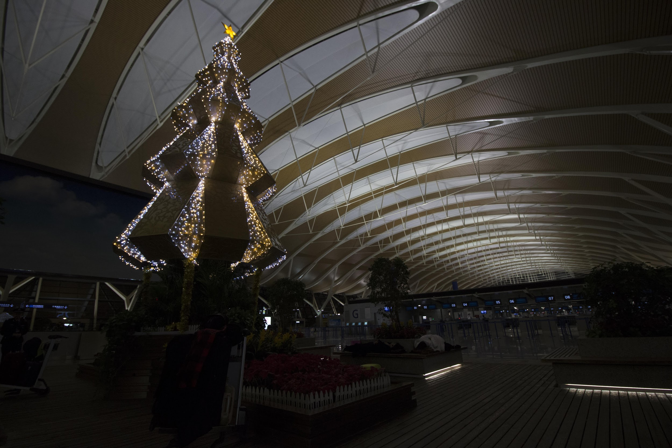
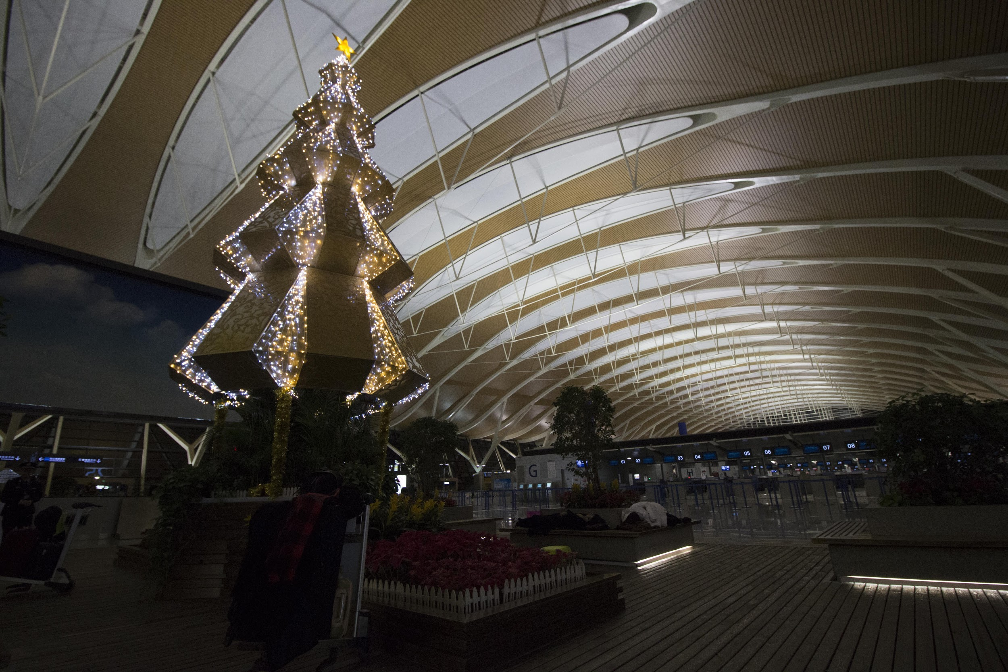
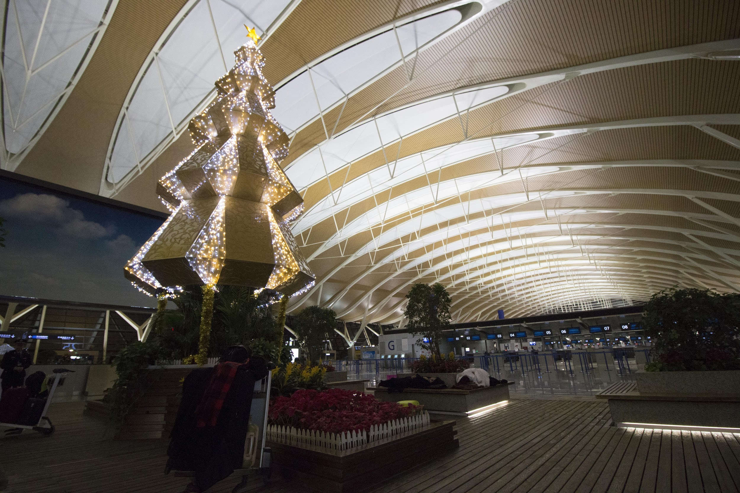
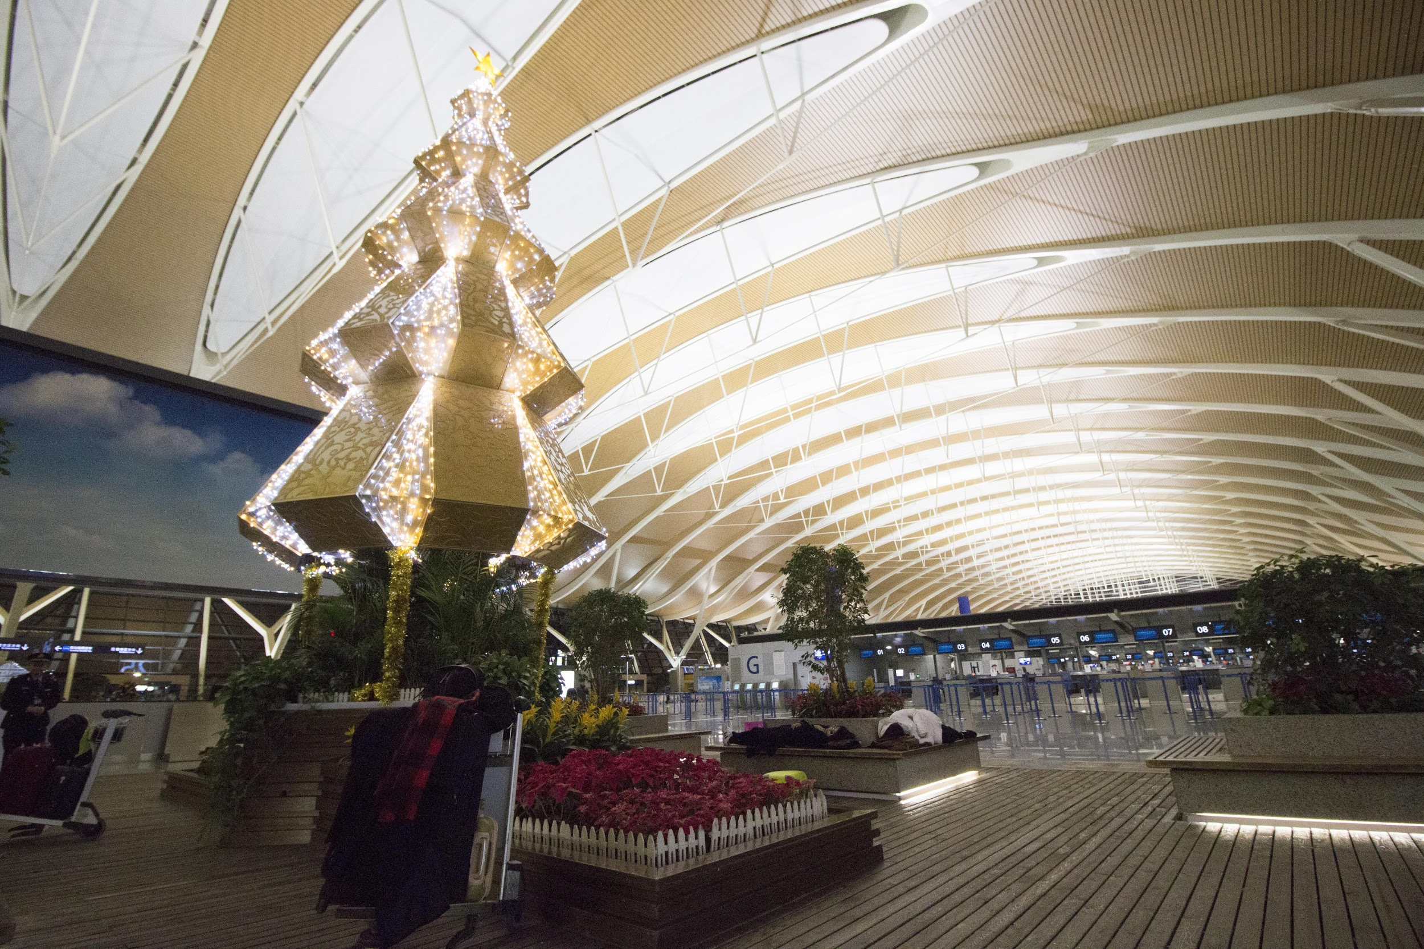
Retraining Complete Dataset
Since Original Zero-DCE just use first part of SICE Datasets.
We tried to retraining using second part of the datasets (Complete Dataset).

Slide 7
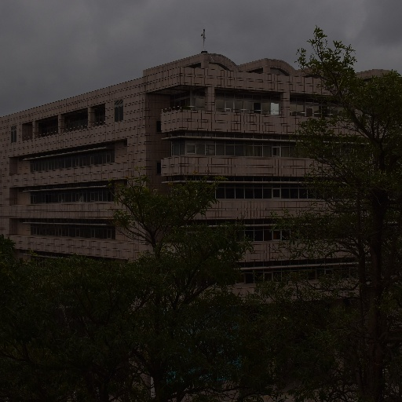
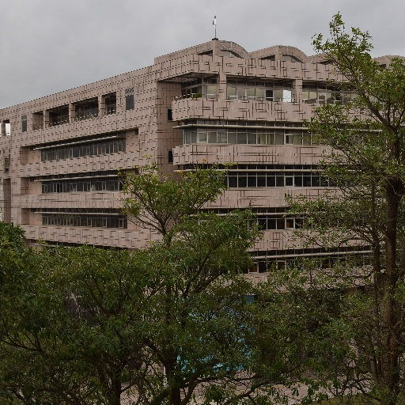
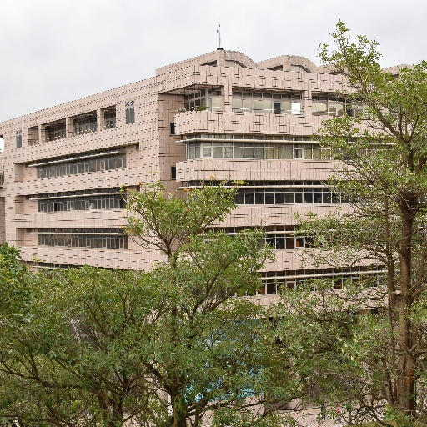
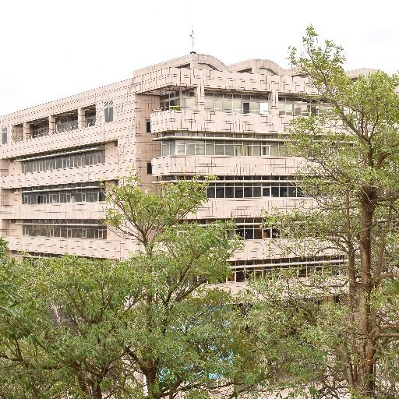
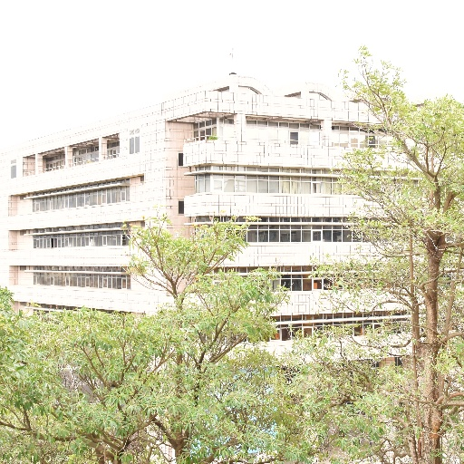
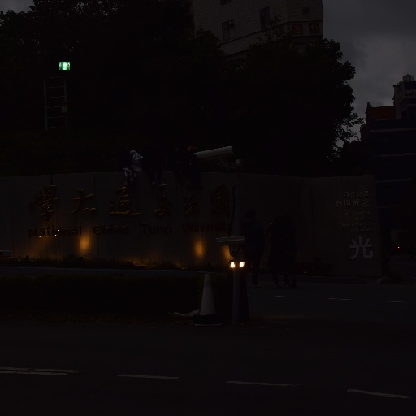
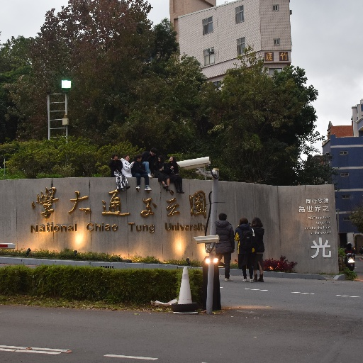
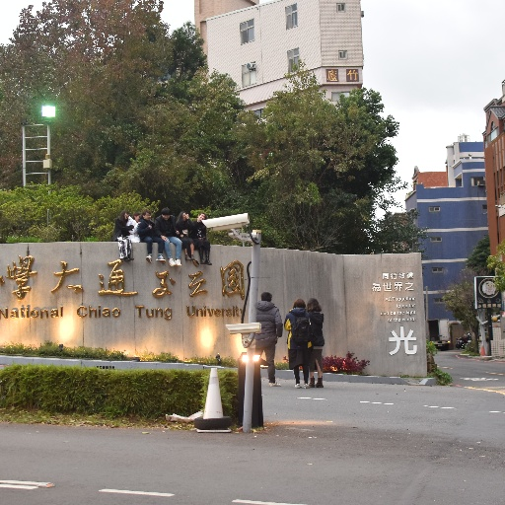
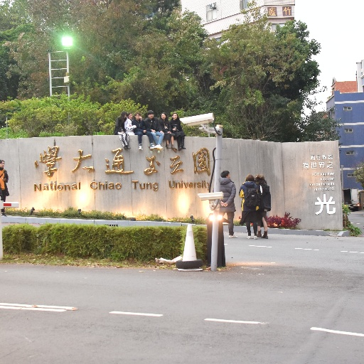
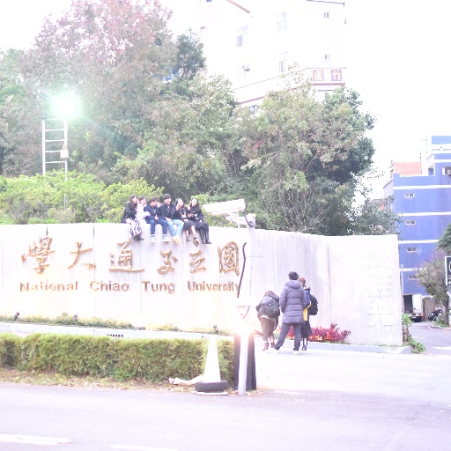
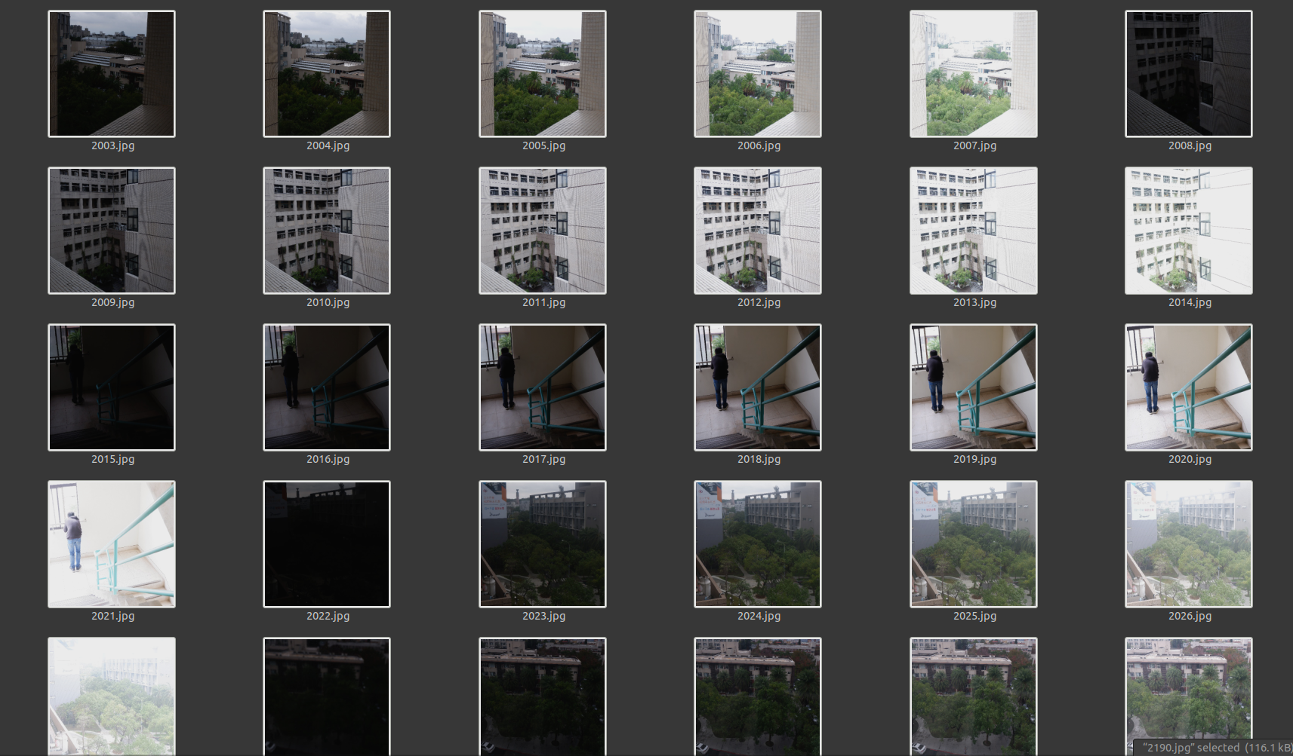
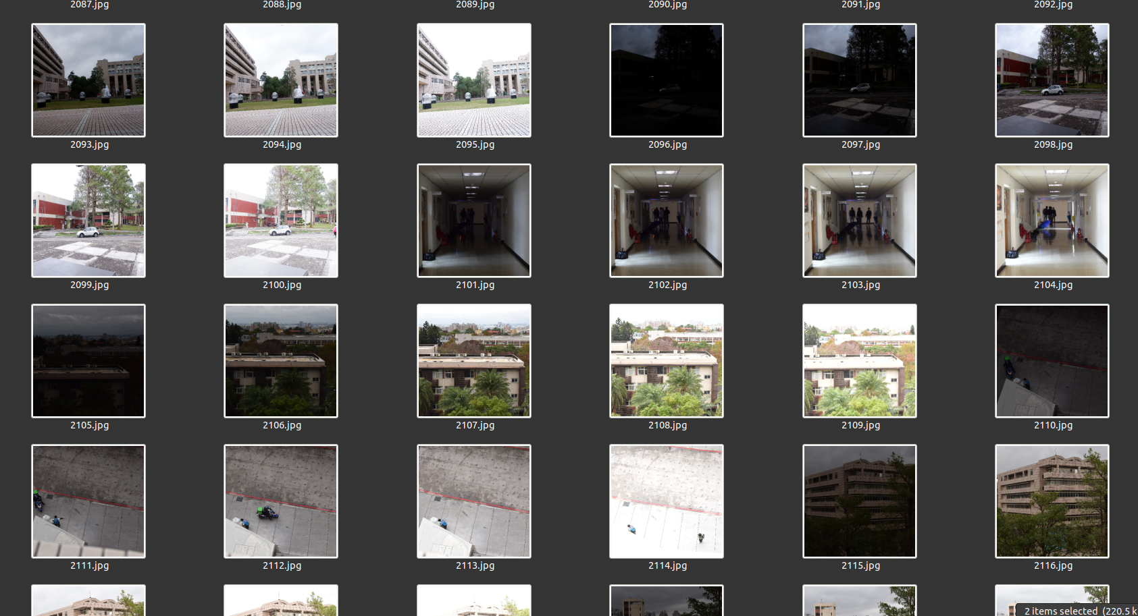
Add Our Own Dataset
Taken with
Fujifilm XT-100
Taken with
Nikon D5300
We add around 190 Photos, with 38 Different Scenes inside NCTU Campus

Slide 8
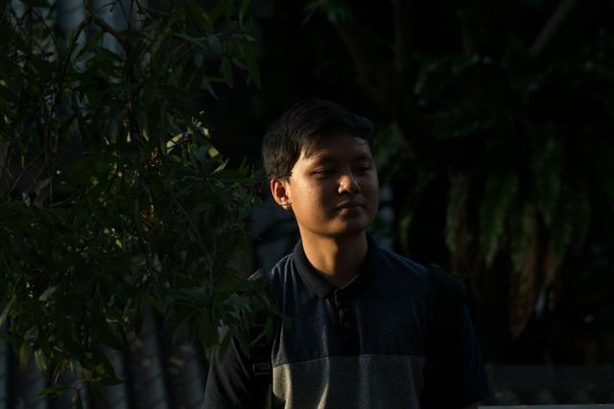
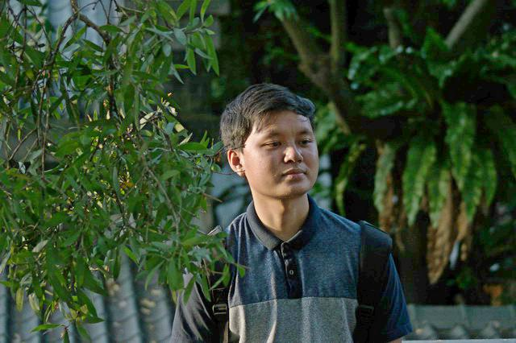
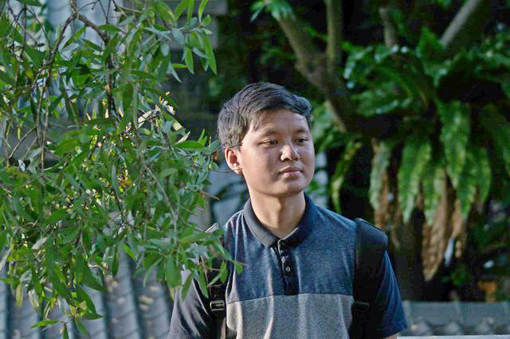
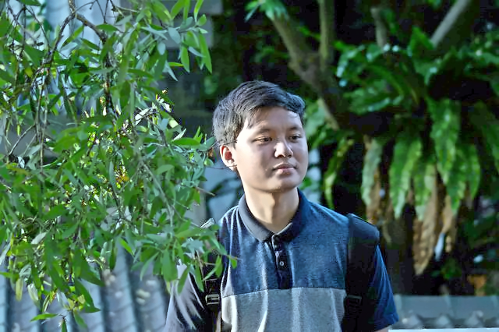
Photo Result
Zero-DCE
(Original)
Zero-DCE
(Extend Dataset)
Input low-light w/
a little source of light
Ours
(ED+CC+D)
ED : Extend Dataset
CC : Color Correction
D : Denoise
Zero-DCE (Extend Dataset) +
Color Correction + Denoise

Slide 9
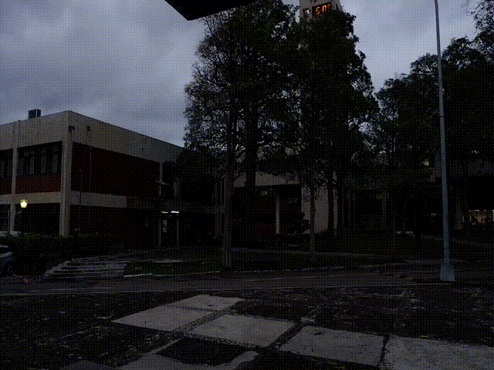
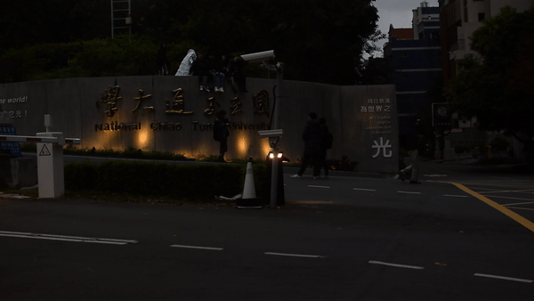
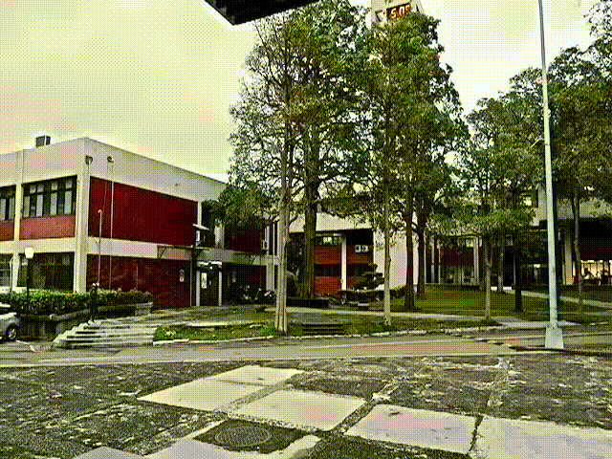
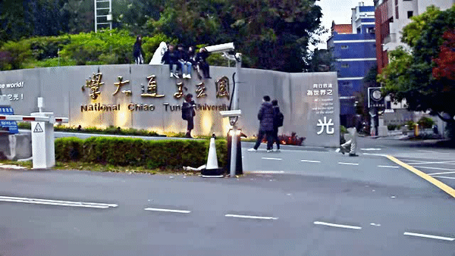
Video Demo
Underexposed Camera Footage
Enhanced with ZeroDCE ED + CC + D
ED : Extend Dataset
CC : Color Correction
D : Denoise

Slide 10
Implementation
(photo)
Real-time photo demo
Capture real-time Image using DSLR Camera
DCE-Zero Network
Color Correction + Denoising
Result
Do the color correction from output of Zero-DCE network and do denoising to enhance the quality of picture.
Real time light enhancement image from DSLR Camera. This is really useful for entry-level camera to perform well in low light without high-spec sensor capability.
Enhance the image with extended SICE dataset using Zero-DCE Network
Capture from DSLR using gPhoto2 and Node-RED (using the lowest ISO)

Slide 11
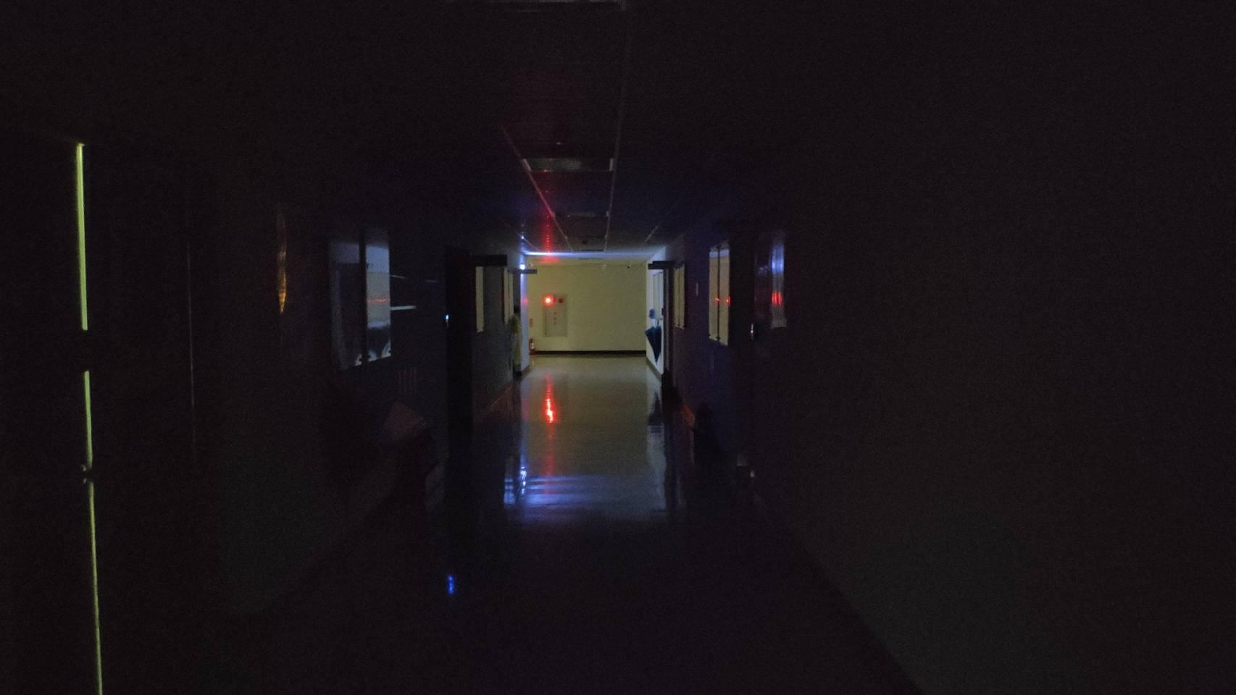
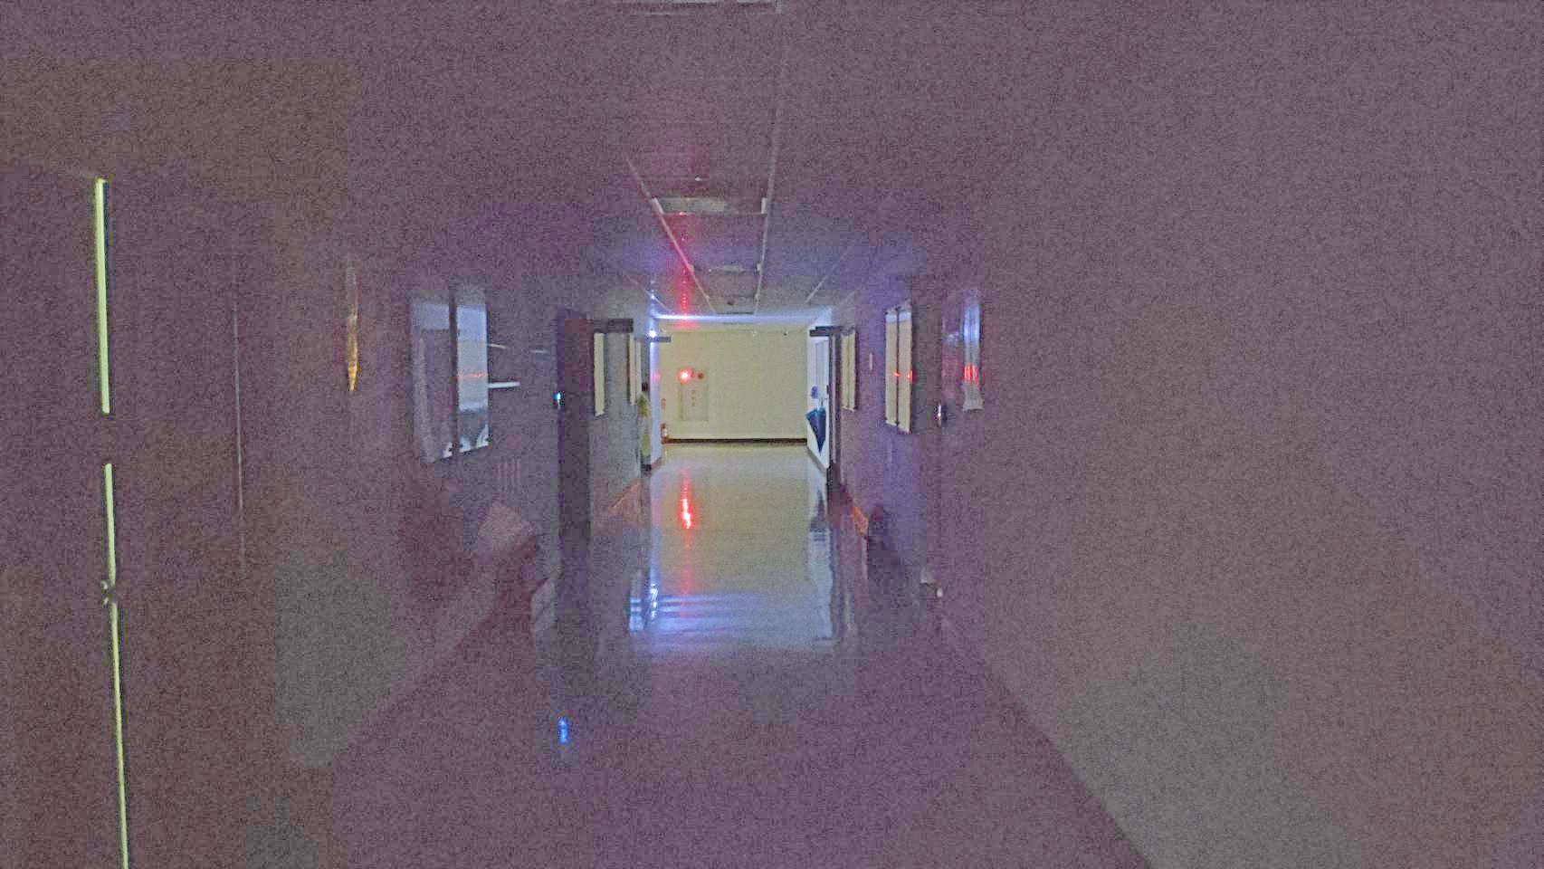
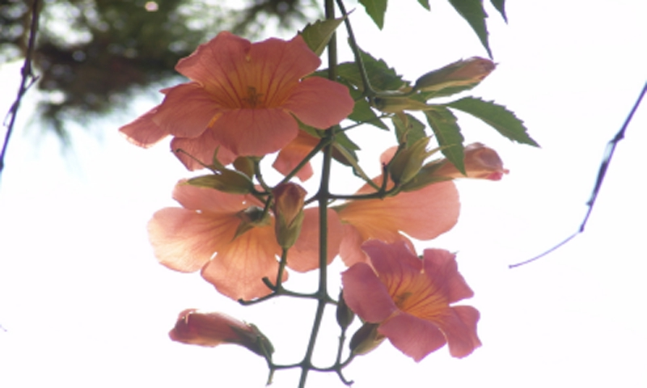
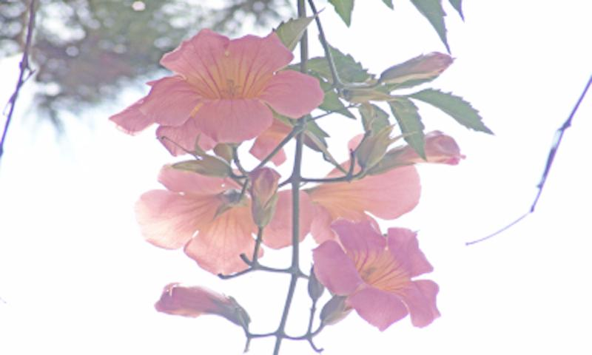
Zero DCE Limitation
Zero DCE
OUTPUT
INPUT
Can’t
Handle
Too dark
And noisy
Not
Adaptive

Slide 12
Thank You!

